Slide 1
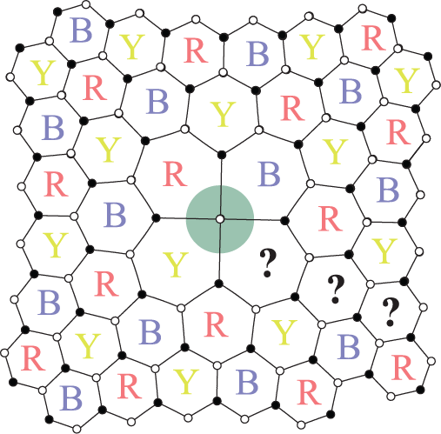
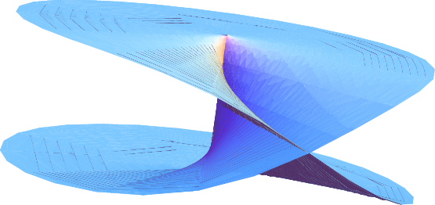

Twist liquids and gauging anyonic symmetries
Jeffrey C.Y. Teo
University of Illinois at Urbana-Champaign
Collaborators:
Taylor Hughes
Eduardo Fradkin
Xiao Chen
Abhishek Roy
Mayukh Khan
To appear soon

Slide 2
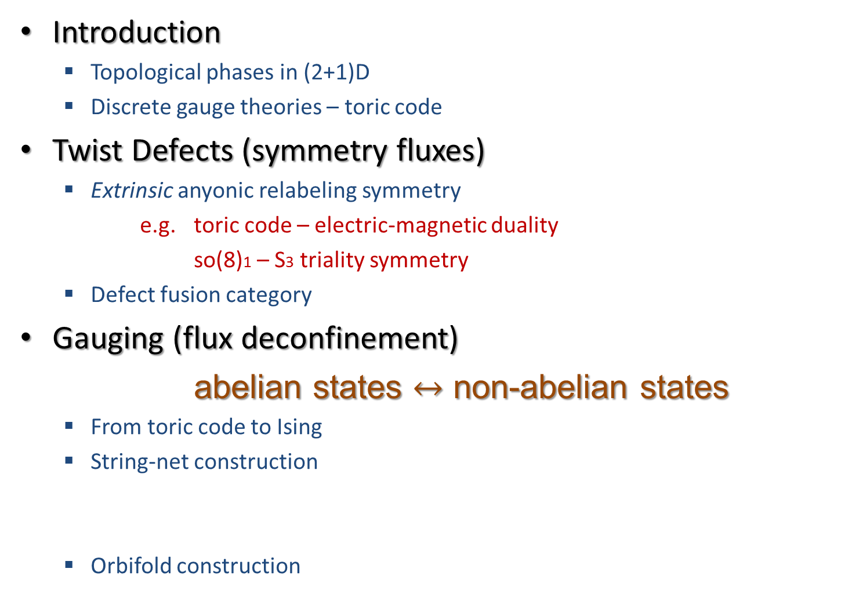
Outline
Introduction
  Topological phases in (2+1)D
  Discrete gauge theories – toric code
Twist Defects (symmetry fluxes)
  Extrinsic anyonic relabeling symmetry
  e.g. toric code – electric-magnetic duality
  so(8)1 – S3 triality symmetry
  Defect fusion category
Gauging (flux deconfinement)
abelian states $↔$ non-abelian states
  From toric code to Ising
  String-net construction
  Orbifold construction
Gauge Z3
Gauge Z2

Slide 3
Introduction

Slide 4
(2+1)D Topological phases
Featureless – no symmetry breaking
Energy gap
No adiabatic connection with trivial insulator
Long range entangled

Slide 5
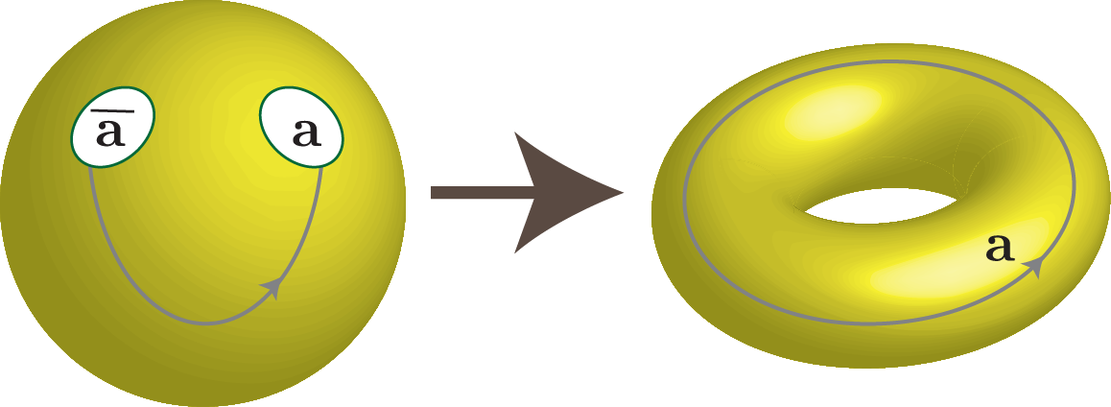
“Topological order”
Ground state degeneracy
  = Number of quasiparticle types (anyons)
Wen, 90

Slide 6
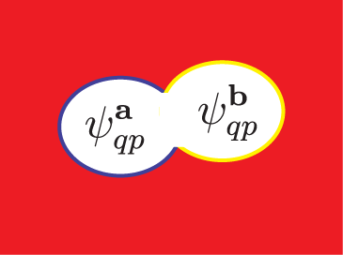
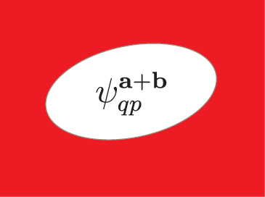

Fusion
Abelian phases
quasiparticle labeled
by lattice vectors

Slide 7
Fusion
Abelian phases
quasiparticle labeled
by lattice vectors
Non-abelian phases

Slide 8

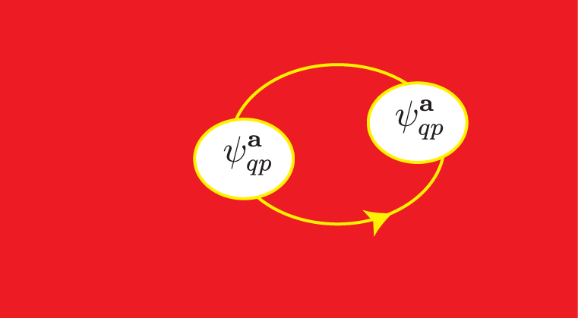
Exchange statistics
Spin – statistics theorem
Exchange phase = 360 twist
=

Slide 9
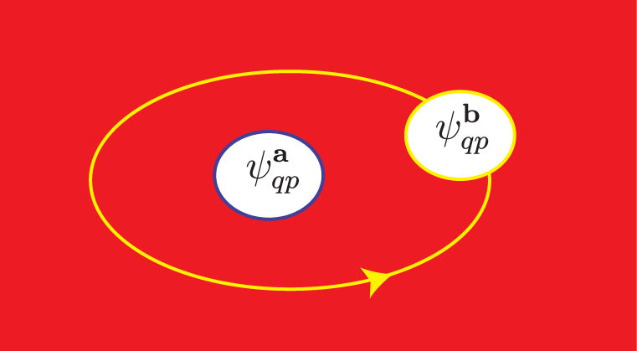
Braiding
Unitary braiding
Ribbon identity
Abelian topological states:

Slide 10
Bulk boundary correspondence
Topological order
Quasiparticles
Fusion
Exchange statistics
Braiding
Boundary CFT
Primary fields
Operator product expansion
Conformal dimension
Modular transformation

Slide 11
Toric code (Z2 gauge theory)
Kitaev, 03; Wen, 03;
Ground state:
for all r

Slide 12
Toric code (Z2 gauge theory)
Kitaev, 03; Wen, 03;
Quasiparticle excitation at r
e – type
m – type

Slide 13
Toric code (Z2 gauge theory)
string of σ’s
Quasiparticle excitation at r
e – type
m – type

Slide 14

Toric code (Z2 gauge theory)
Quasiparticles: 1 = vacuum
e = Z2 charge
m = Z2 flux
ψ = e $×$ m
Braiding:
Electric-magnetic symmetry:

Slide 15
Discrete gauge theories
Finite gauge group G
Flux – conjugacy class
Charge – irreducible representation

Slide 16
Discrete gauge theories
Quasiparticle = flux-charge composite
Total quantum dimension
Conjugacy class
Irr. Rep. of
centralizer of g
topological
entanglement
entropy

Slide 17
Gauging
- Gauging
- Flux deconfinement
Trivial boson condensate
Discrete gauge theory
- Charge condensation
- Flux confinement
Global static
symmetry
Local dynamical
symmetry
Less topological order
(abelian)
- Gauging
- Defect deconfinement
More topological order
(non-abelian)
- Charge condensation
- Flux confinement
JT, Hughes, Fradkin, to appear soon

Slide 18
Anyonic symmetry and twist defects

Slide 19
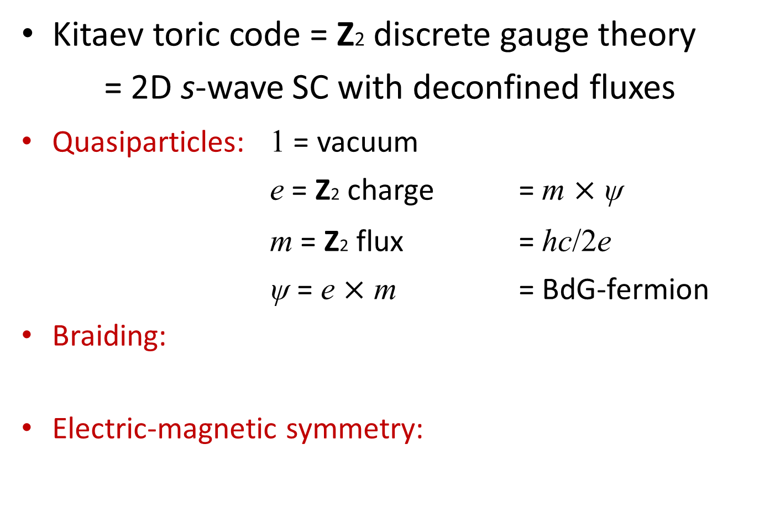
Anyonic symmetry
Kitaev toric code = Z2 discrete gauge theory
= 2D s-wave SC with deconfined fluxes
Quasiparticles: 1 = vacuum
e = Z2 charge = m $×$ ψ
m = Z2 flux = hc/2e
ψ = e $×$ m = BdG-fermion
Braiding:
Electric-magnetic symmetry:

Slide 20
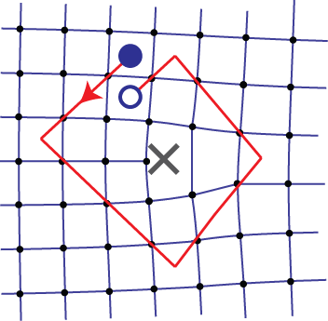
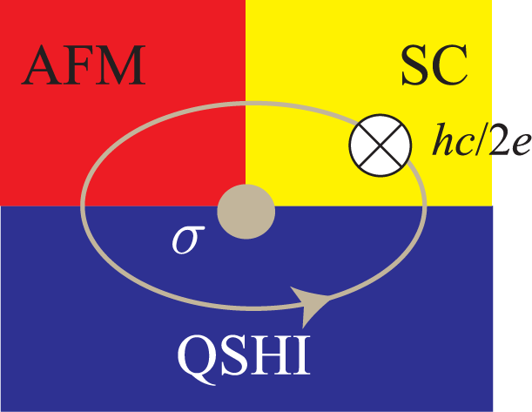
Twist defect
“Dislocations” in Kitaev toric code
Majorana zero mode at QSHI-AFM-SC
e
m
Vortex states
H. Bombin, PRL 105, 030403 (2010)
A. Kitaev and L. Kong,
Comm. Math. Phys. 313, 351 (2012)
You and Wen, PRB 86, 161107(R) (2012)
Khan, JT, Vishveshwara, to appear soon

Slide 21
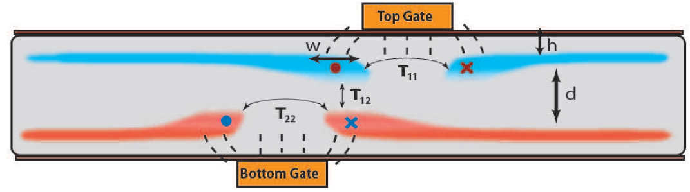
Twist defect
“Dislocations” in bilayer FQH states
M. Barkeshli and X.-L. Qi,
Phys. Rev. X 2, 031013 (2012)
M. Barkeshli and X.-L. Qi, arXiv:1302.2673 (2013)

Slide 22

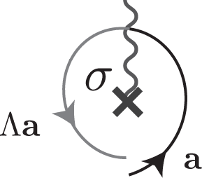
Twist defect
Semiclassical topological point defect

Slide 23

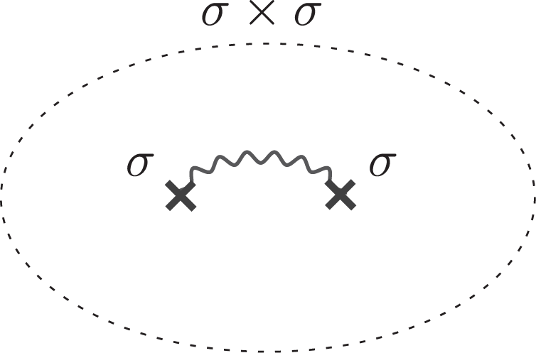
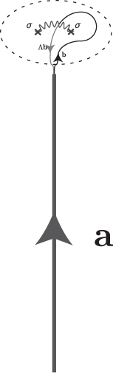
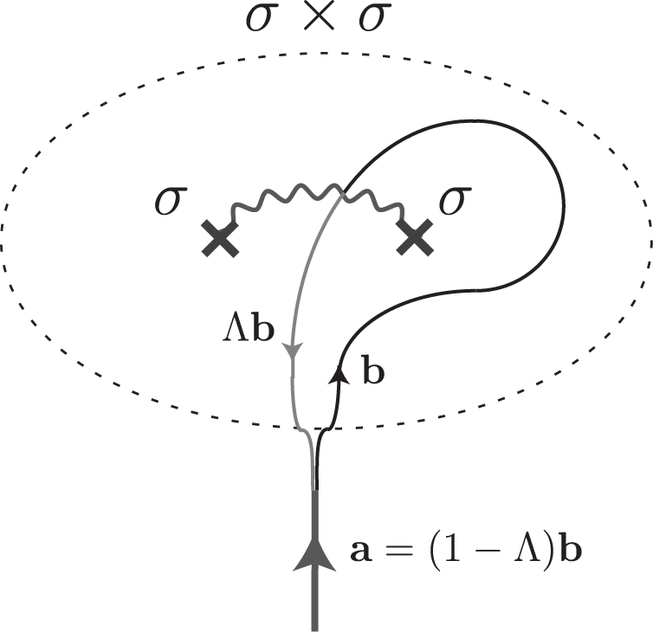
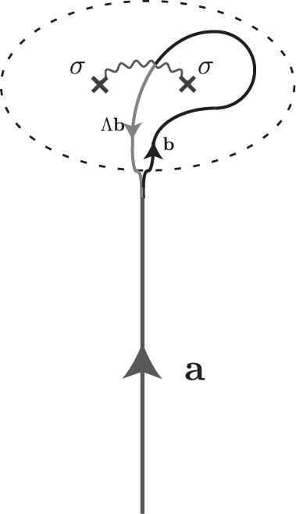
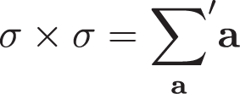
Non-abelian fusion
Splitting state
JT, A. Roy, X. Chen, arXiv:1306.1538; arXiv:1308.5984 (2013)

Slide 24
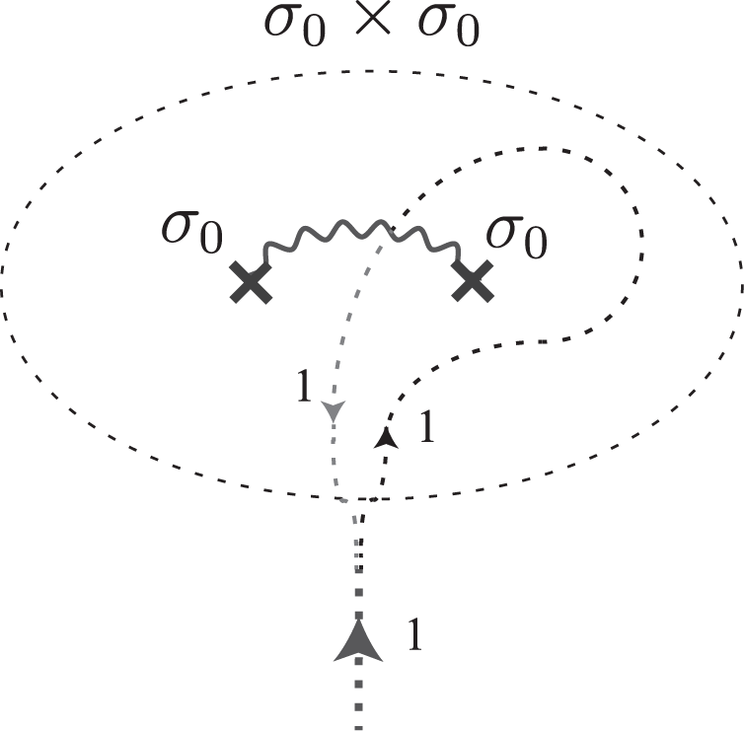
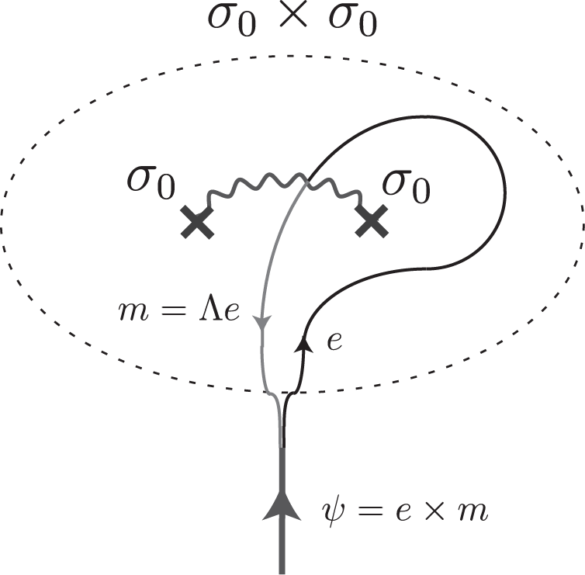


Non-abelian fusion
JT, A. Roy, X. Chen, arXiv:1306.1538; arXiv:1308.5984 (2013)

Slide 25

so(8)1
Edge CFT: so(8)1 Kac-Moody algebra
Strongly coupled 8 $×$ (p+ip) SC
Surface of a topological paramagnet (SPT)
condense
Burnell, Chen, Fidkowski, Vishwanath, 13
Wang, Potter, Senthil, 13

Slide 26

so(8)1
K-matrix = Cartan matrix of so(8)
3 flavors of fermions
Mutual semions
fermions

Slide 27
so(8)1
Khan, JT, Hughes, arXiv:1403.6478 (2014)

Slide 28
Defects in so(8)1
Twofold defect
Threefold defect
Khan, JT, Hughes, arXiv:1403.6478 (2014)

Slide 29

Defect fusions in so(8)1
Multiplicity
Non-commutative
Twofold defect
Threefold defect
Khan, JT, Hughes, arXiv:1403.6478 (2014)

Slide 30
Defect fusion category
G-graded tensor category
Toric code with defects
Basis transformation
JT, Hughes, Fradkin, to appear soon

Slide 31
Defect fusion category
Fusion
Basis transformation
Obstructed by
Classified by
Abelian quasiparticles
3D SPT
Non-symmorphic symmetry group
2D SPT
Frobenius-Shur indicators
JT, Hughes, Fradkin, to appear soon

Slide 32
Gauging anionic symmetries

Slide 33
From semiclassical defects to quantum fluxes
- Gauging
- Defect deconfinement
Global extrinsic symmetry
Local gauge symmetry
- Charge condensation
- Flux confinement
(Bais-Slingerland)
JT, Hughes, Fradkin, to appear soon

Slide 34
Discrete gauge theories
- Gauging
- Defect deconfinement
Trivial boson condensate
Discrete gauge theory
- Charge condensation
- Flux confinement
Quasiparticle = flux-charge composite
Total quantum dimension
Conjugacy class
Representation of centralizer of g

Slide 35
General gauging expectations
Less topological order
(abelian)
- Gauging
- Defect deconfinement
More topological order
(non-abelian)
- Charge condensation
- Flux confinement
Quasipartice = flux-charge-anyon composite
Conjugacy class
Super-sector of
underlying topological state
Representation of centralizer of g
JT, Hughes, Fradkin, to appear soon

Slide 36
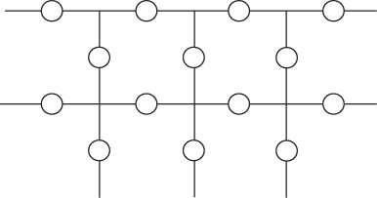
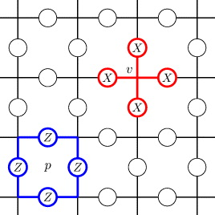
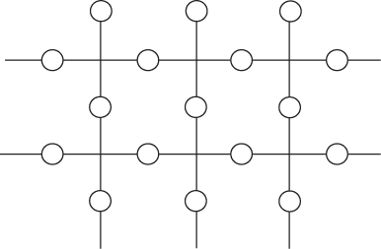


Toric code $→$ Ising
Z2 gauge theory
Ising $×$ Ising
Edge theory
e condensation
c = 1/2
c = 1/2
c = 1
c = 1
m condensation
Kitaev toric code

Slide 37
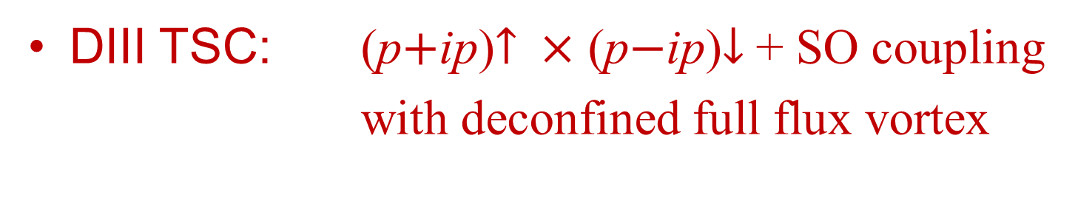
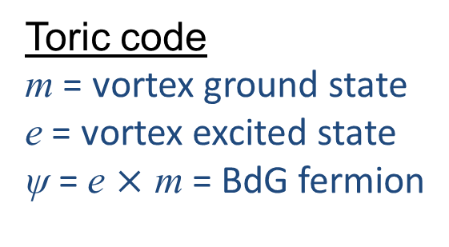
Toric code $→$ Ising
Gauging fermion parity
Z2 gauge theory
Ising $×$ Ising
DIII TSC: (p$+$ip)$↑$ $×$ (p$−$ip)$↓$ + SO coupling
with deconfined full flux vortex
Toric code
m = vortex ground state
e = vortex excited state
ψ = e $×$ m = BdG fermion

Slide 38
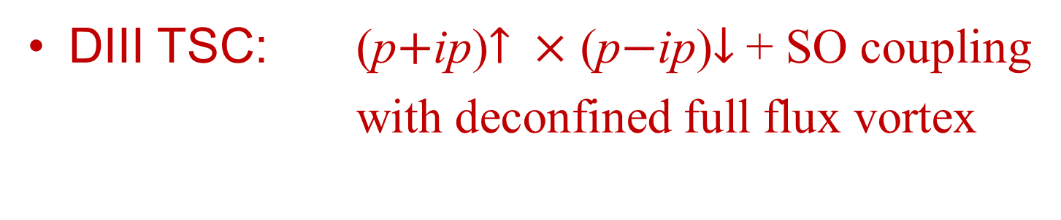
Toric code $→$ Ising
Gauging fermion parity
Z2 gauge theory
Ising $×$ Ising
DIII TSC: (p$+$ip)$↑$ $×$ (p$−$ip)$↓$ + SO coupling
with deconfined full flux vortex
Half vortex
= Twist defect
Gauge FP
Ising anyon

Slide 39
Toric code $→$ Ising
Z2 gauge theory
Ising $×$ Ising
- Fermion pair condensation
- Ising anyon confinement
condense
confine

Slide 40
Toric code $→$ Ising
- Gauging e-m symmetry
- Defect deconfinement
Z2 gauge theory
Ising $×$ Ising
General gauging procedure
  Defect fusion category
  + F-symbols
  String-net model (Levin-Wen) a.k.a. Drinfeld construction
JT, Hughes, Fradkin, to appear soon

Slide 41
Toric code $→$ Ising
- Gauging e-m symmetry
- Defect deconfinement
Z2 gauge theory
Ising $×$ Ising
Drinfeld anyons
Defect fusion object
Exchange
JT, Hughes, Fradkin, to appear soon

Slide 42
Toric code $→$ Ising
- Gauging e-m symmetry
- Defect deconfinement
Z2 gauge theory
Ising $×$ Ising
Drinfeld anyons
Z2 charge
JT, Hughes, Fradkin, to appear soon

Slide 43
Toric code $→$ Ising
- Gauging e-m symmetry
- Defect deconfinement
Z2 gauge theory
Ising $×$ Ising
Drinfeld anyons
Z2 fluxes
4 solutions:
JT, Hughes, Fradkin, to appear soon

Slide 44
Toric code $→$ Ising
- Gauging e-m symmetry
- Defect deconfinement
Z2 gauge theory
Ising $×$ Ising
Drinfeld anyons
Super-sector
JT, Hughes, Fradkin, to appear soon

Slide 45

Toric code $→$ Ising
- Gauging e-m symmetry
- Defect deconfinement
Z2 gauge theory
Ising $×$ Ising
Total quantum dimension
($\sim$topological entanglement entropy)
JT, Hughes, Fradkin, to appear soon

Slide 46
Gauging multiplicity
- Gauging e-m symmetry
- Defect deconfinement
Z2 gauge theory
Ising $×$ Ising
Inequivalent F-symbols
Frobenius-Schur indicator
JT, Hughes, Fradkin, to appear soon

Slide 47
Gauging multiplicity
- Gauging e-m symmetry
- Defect deconfinement
Z2 gauge theory
Ising $×$ Ising
Spins of Z2 fluxes
JT, Hughes, Fradkin, to appear soon

Slide 48
Gauging multiplicity
- Gauging e-m symmetry
- Defect deconfinement
Z2 gauge theory
Ising $×$ Ising
Spins of Z2 fluxes
JT, Hughes, Fradkin, to appear soon

Slide 49
Gauging triality of so(8)1
Gauge Z2
Gauge Z2
JT, Hughes, Fradkin, to appear soon

Slide 50
Gauging triality of so(8)1
Gauge Z3
JT, Hughes, Fradkin, to appear soon

Slide 51
Gauging triality of so(8)1
Gauge Z3
Gauge Z2
?
JT, Hughes, Fradkin, to appear soon

Slide 52

Gauging triality of so(8)1
Gauge Z3
Gauge Z2
Total quantum dimension
($\sim$topological entanglement entropy)
JT, Hughes, Fradkin, to appear soon

Slide 53
Comments on CFT orbifolds
Bulk-boundary correspondence
topological order edge CFT
gauging orbifolding
Example: Laughlin 1/m state
edge u(1)m/2 –CFT
u(1)/Z2 orbifold (Dijkgraaf, Vafa, Verlinde, Verlinde)
bilayer FQH (Barkeshli, Wen)
Drawbacks
  Not deterministic and requires “insight” in general
  Unstable upon addition of 2D SPT’s
Chen, Abhishek, JT, to appear soon

Slide 54
Conclusion
Anyonic symmetries and twist defects
  Examples: Kitaev toric code
  so(8)1
Gauging anionic symmetries
Less topological order
(abelian)
- Gauging
- Defect deconfinement
More topological order
(non-abelian)
- Charge condensation
- Flux confinement

